Slide 1
FWD Project
TOGAF 9 - Core Diagrams
Class Diagram
Phase C – Information Systems Architectures

Slide 2
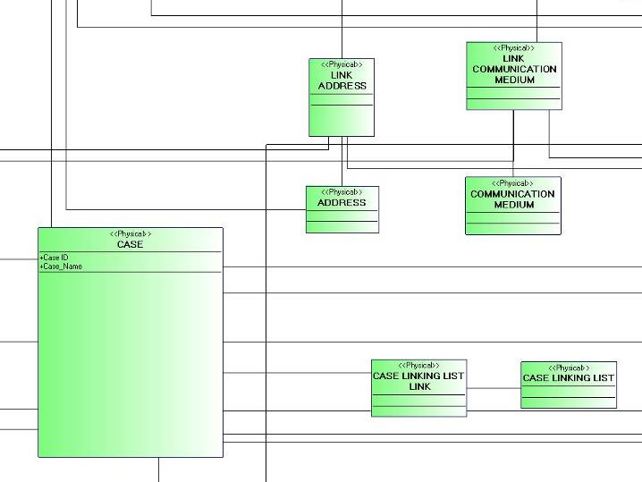
Class Diagram

Slide 3
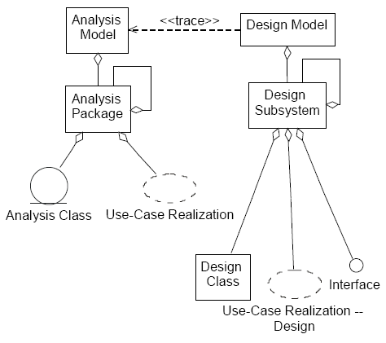
Class Diagram

Slide 4
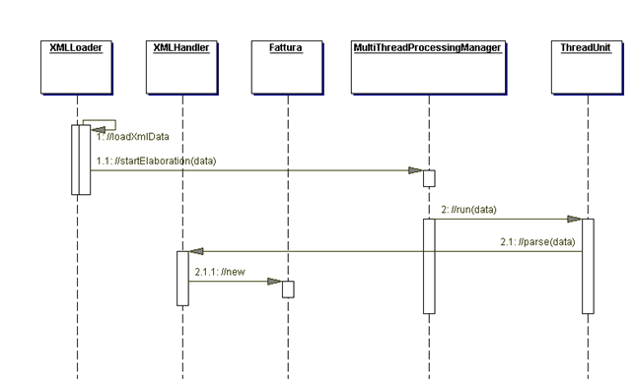
Class Diagram

